Slide 1
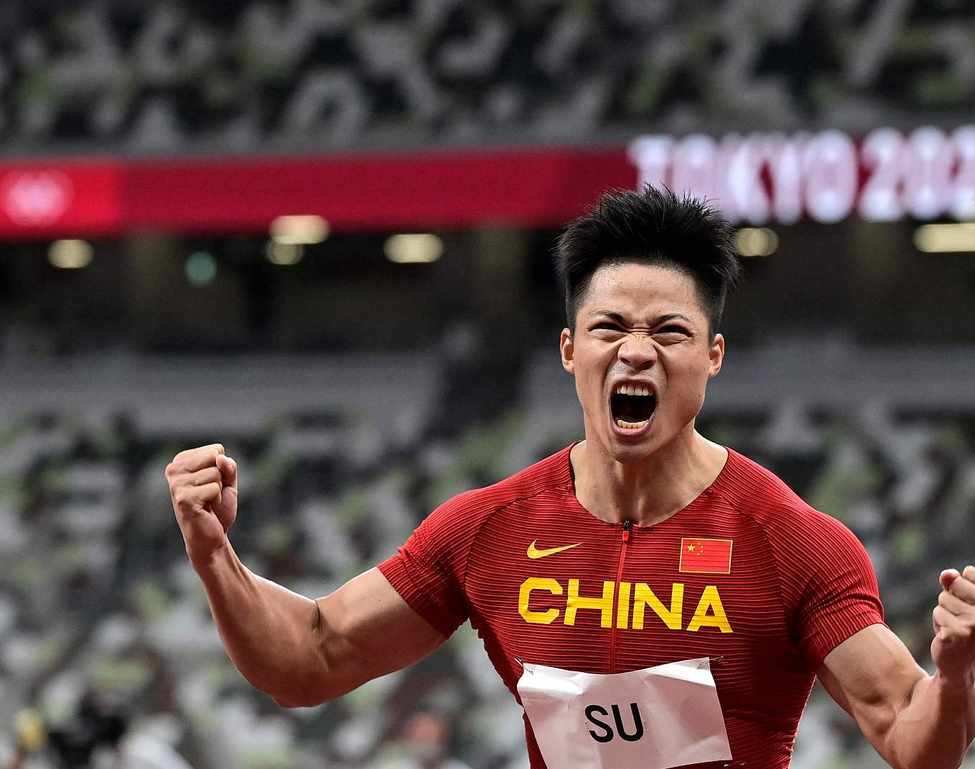
Attention Grabber

Slide 2
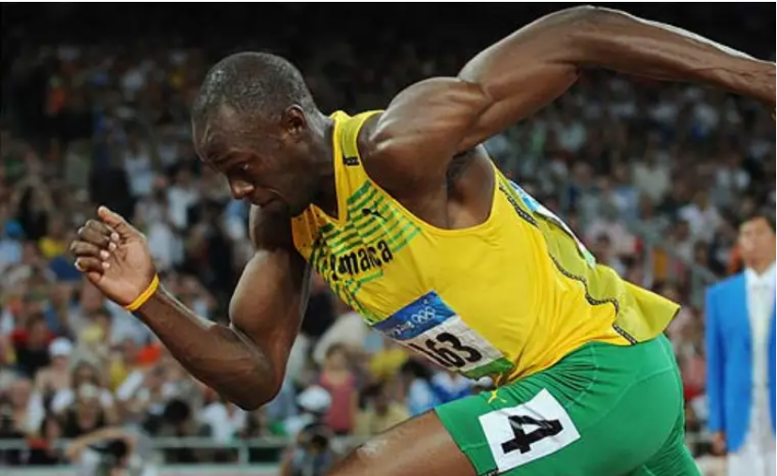
Method for Predicting
2024 Paris Olympic Games Men’s 100m

Slide 3
Introduction to the Group

Slide 4

Youyao Gao
Gender: Male
Nationality: China
Hometown: Shanghai
College: University of Nottingham Ningbo China
Emial: scyyg6@nottingham.edu.cn
youyaogao@gmail.com
15221996168@163.com
Contact Number: +86 15221996168
Computer skills: Python, C, java, Haskell, SQLite, HTML, CSS, Matlab, R, Geogebra, Latex
Language skills: English, Mandarin
Research interest: Data Science, Machine Learning, Computer Vision

Slide 5
Yu Liang

Slide 6
Haosong Sun
Gender: MALE
College: Beijing University of Posts and Telecommunications
Major: Electronic Information Engineering
Email: mrsun666@126.com
shs2022@bupt.edu.com
Skills: C/C++, Python, MATLAB
Interests: Machine Learning, Deep Learning, Signal Processing

Slide 7
XinYi Zeng
Gender: FEMALE
College: Southern University of Science and Technology
Major: Data Science
Email: 12212355@mail.sustech.edu.cn
Skills: Java, Python, R
Interests: Machine Learning, Deep Learning, Data Analysis

Slide 8
Outline
1. Pre-Project Preparations
· Waterfall Method and Agile Method
2. Development
· Data Collection (Web Scraping)
· Data Preprocessing (Data Cleaning)
· Feature Engineering (Correlation Analysis, PCA)
· Logistic Regression (Binary Classification)
· Model Building, Training, and Testing
· Model Evaluation (Class 1-9 Prediction)
3. Conclusion

Slide 9
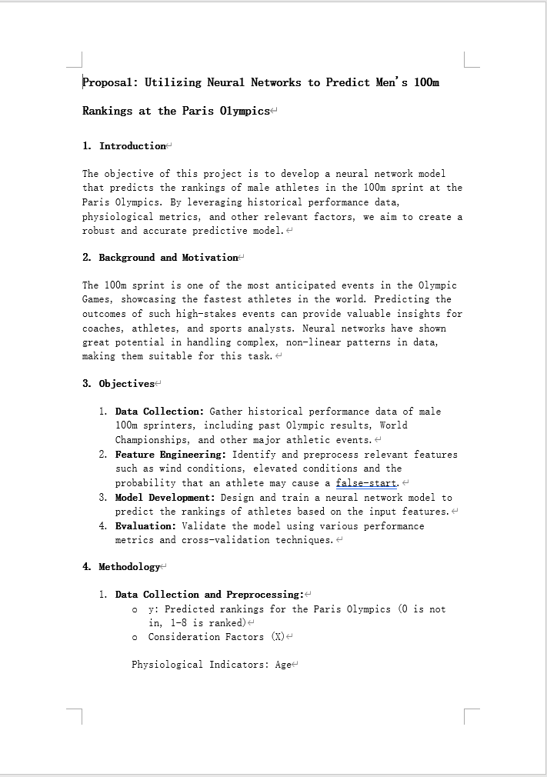
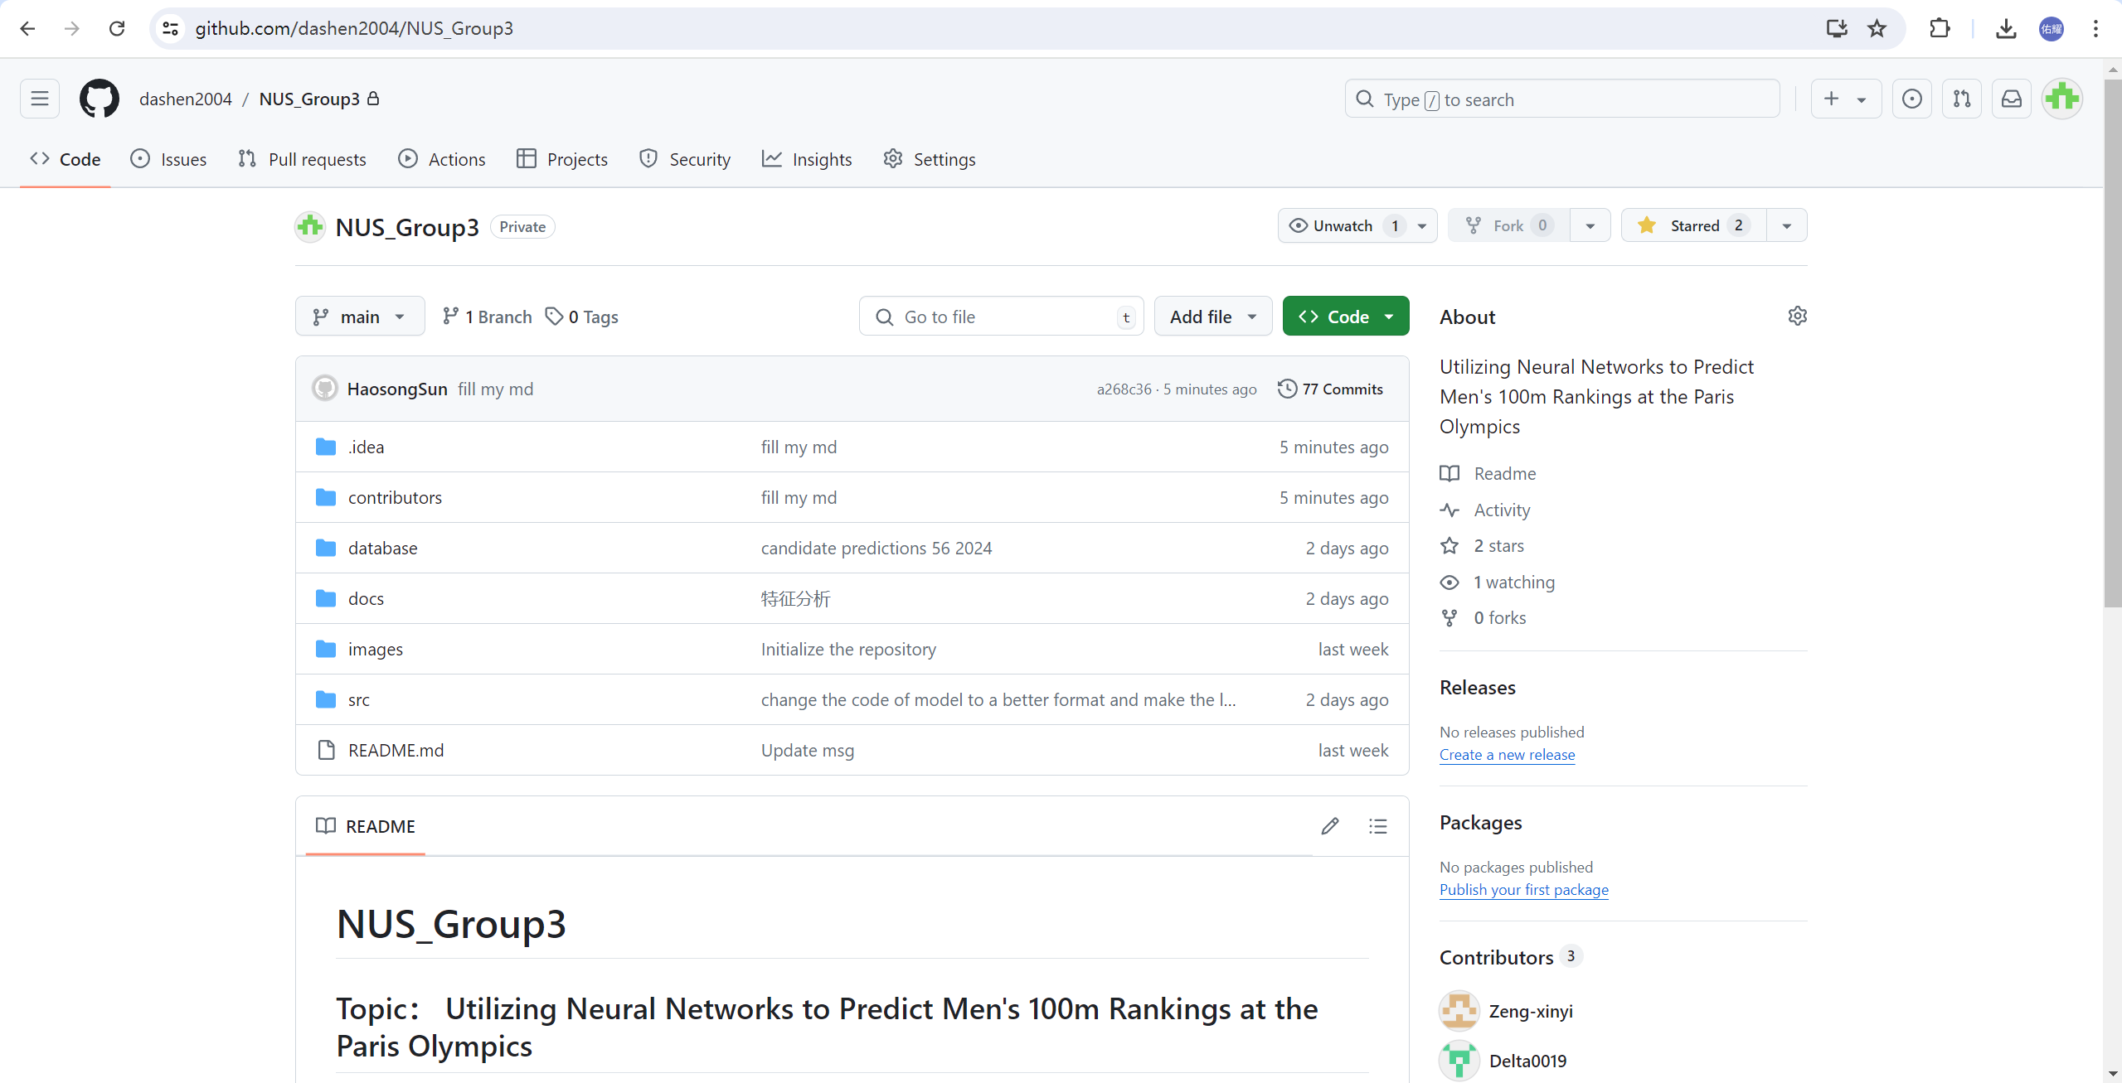
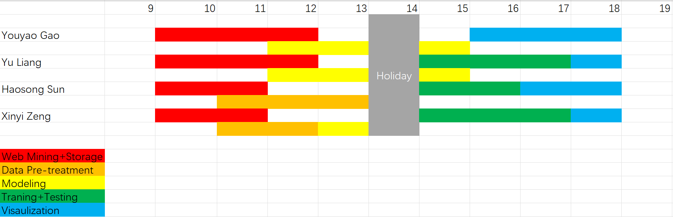
Pre-Project Preparations: Waterfall Method and Agile Method

Slide 10
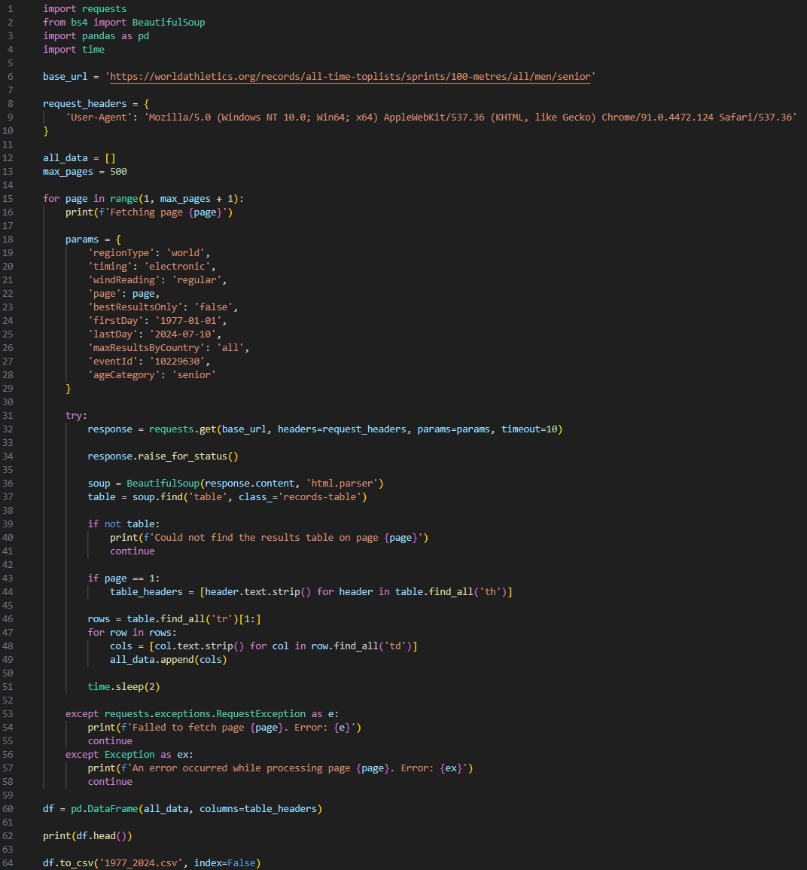
Development : Data Collection
(World Athletics, 2024)

Slide 11
Development : Data Collection
(World Athletics, 2024)

Slide 12
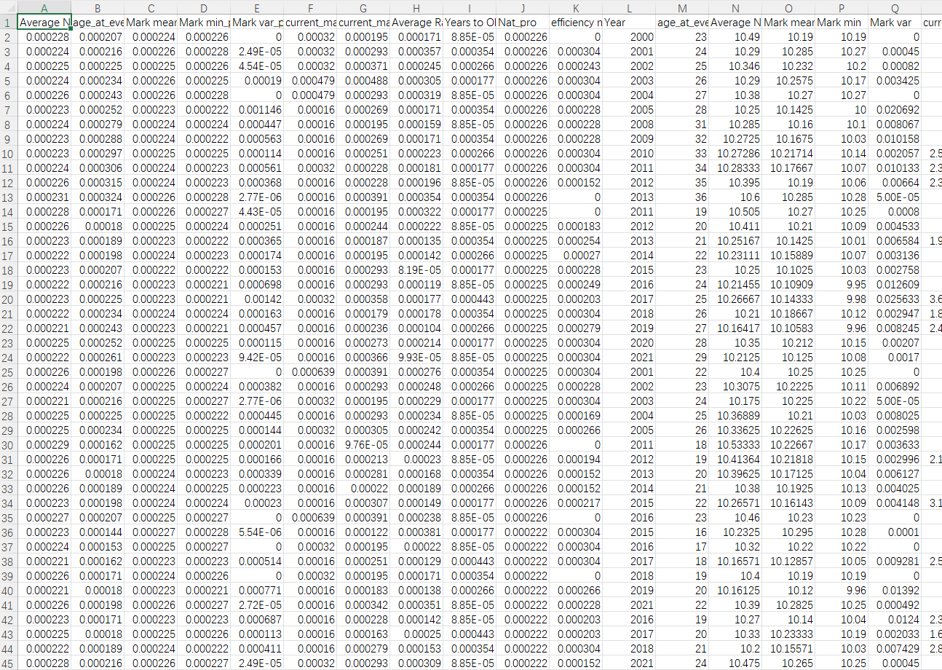
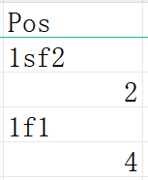
Development : Data Preprocessing
Handle missing data and outliers.
Remove athlete records totaling less than ten.
Format the data.
Example:
'Pos' column (contains the competition group and ranking)
(1) 97 blank values( 0.27%)
(2) The format is not uniform.

Slide 13
Development : Data Preprocessing
predictor variable：
- Age at event
- Average Net Result mean
- Mean mark
- Best mark (min)
- Variance of the mark
- Mean match ranking
- Best match ranking (min)
- Average Rank mean
- Mean efficiency
- Nation Score
- Years to Olympics
response variable：
1 Finalist_weight: whether they entered the final
2 Olympic Ranking
Second processing to identify potential influencing factors (analyzed annually)
* Perform another round of missing data and outlier handling
normalization of data

Slide 14
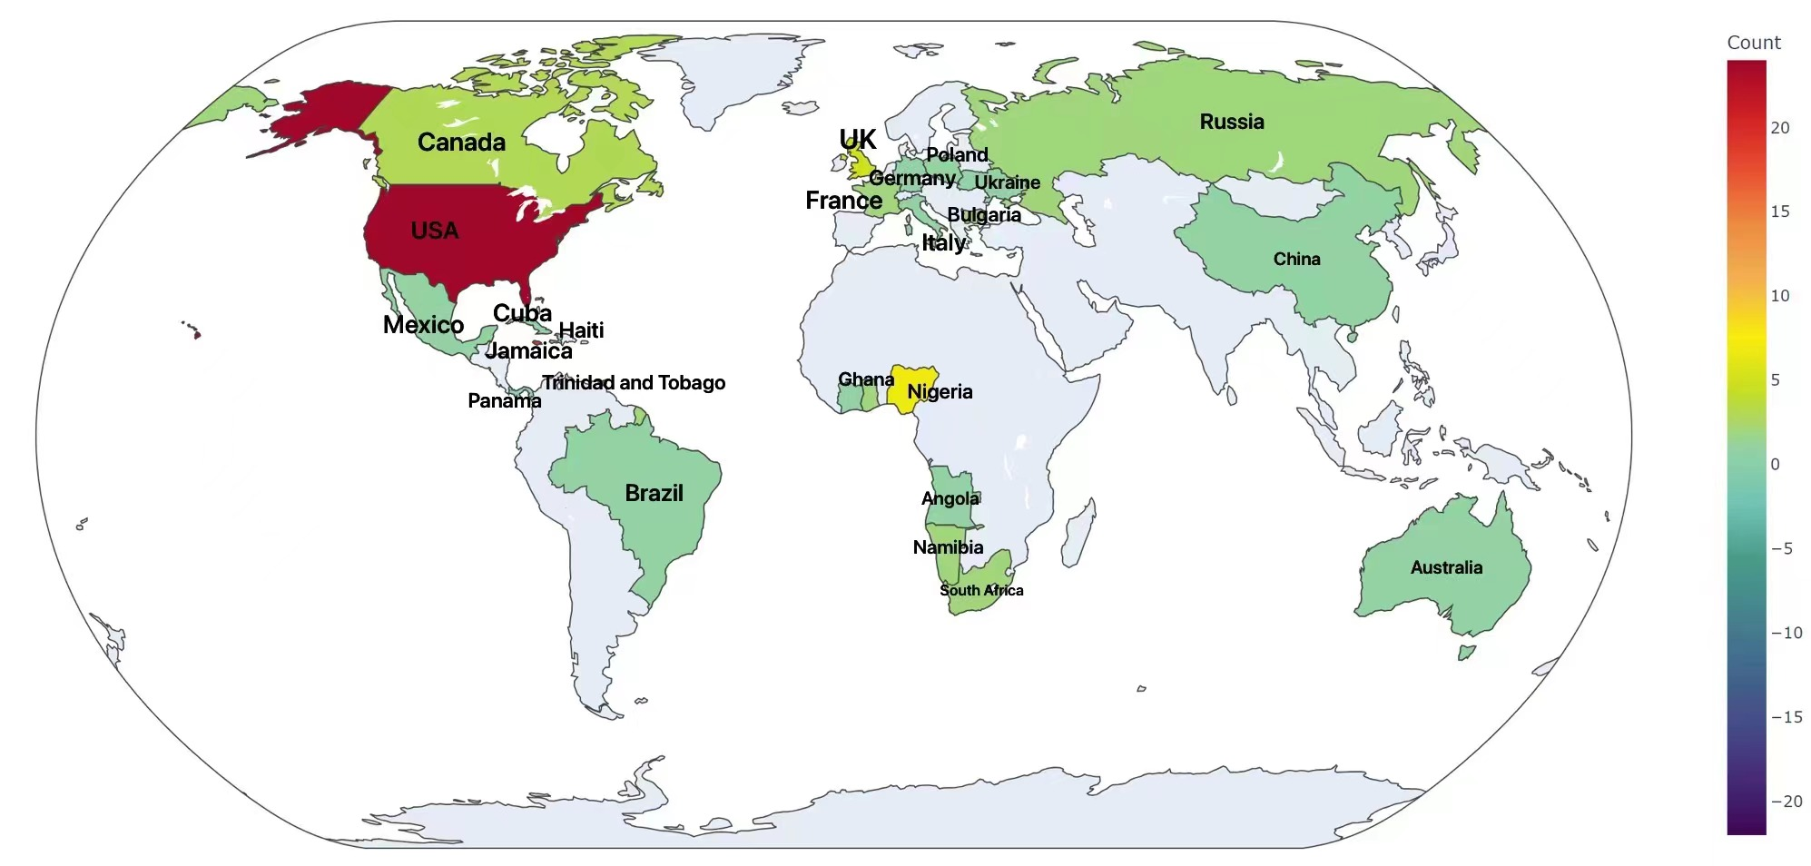
the countries of origin for athletes who entered the men's 100 meters final at the Olympics
country | count
USA | 24
Jamaica | 19
Nigeria | 7
Trinidad and Tobago | 6
Naturalized athlete ratio: 8.2%
United States of America | 24
Jamaica | 19
Nigeria | 7
United States of America | 24
Jamaica | 19
Nigeria | 7
United States of America | 24
Jamaica | 19
Nigeria | 7
United States of America | 24
Jamaica | 19
Nigeria | 7

Slide 15
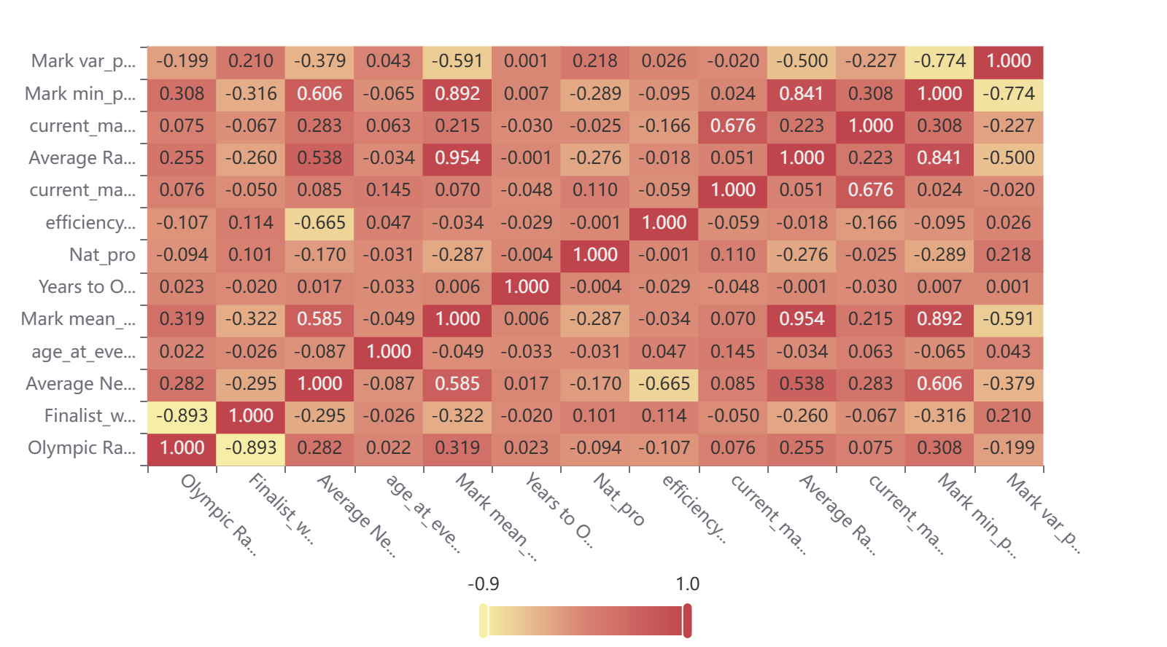
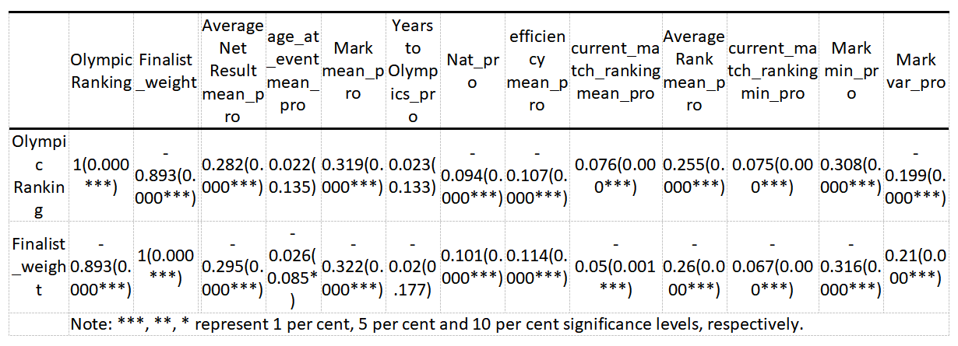
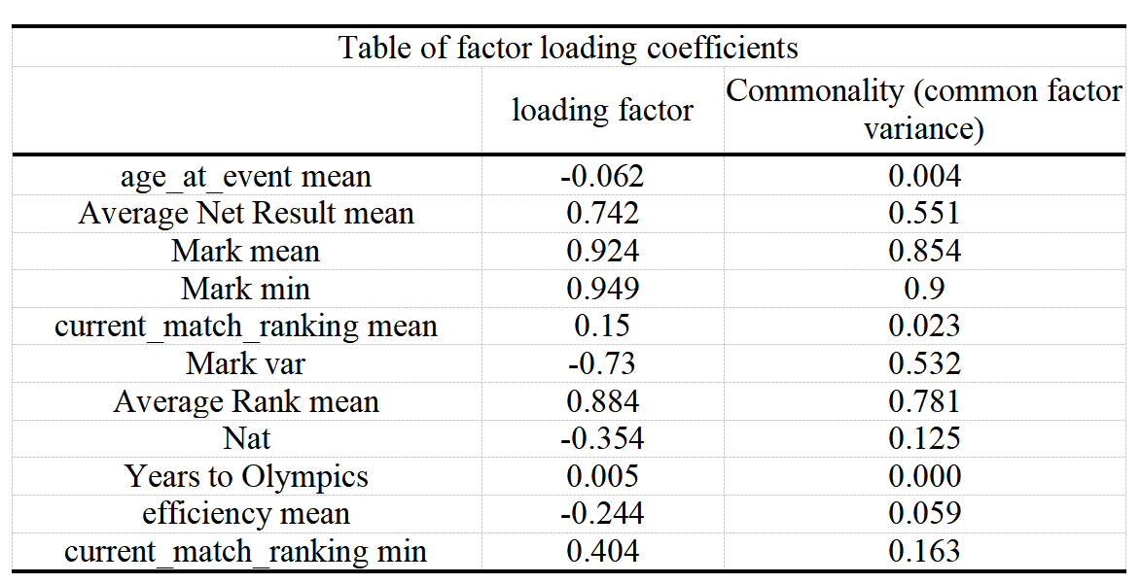
Development :
Feature Engineering

Slide 16
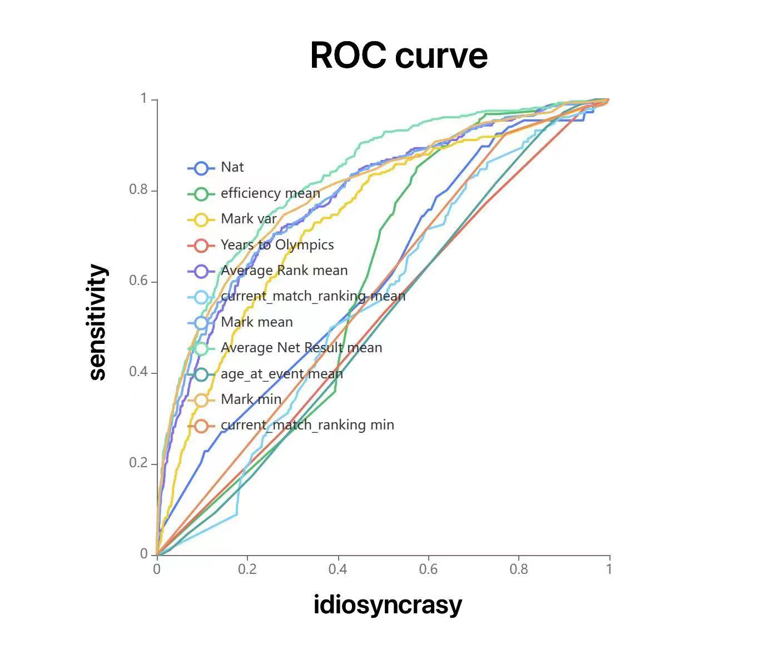
Development : Feature Engineering
ROC curve
State variable: Finalist_weight

Slide 17
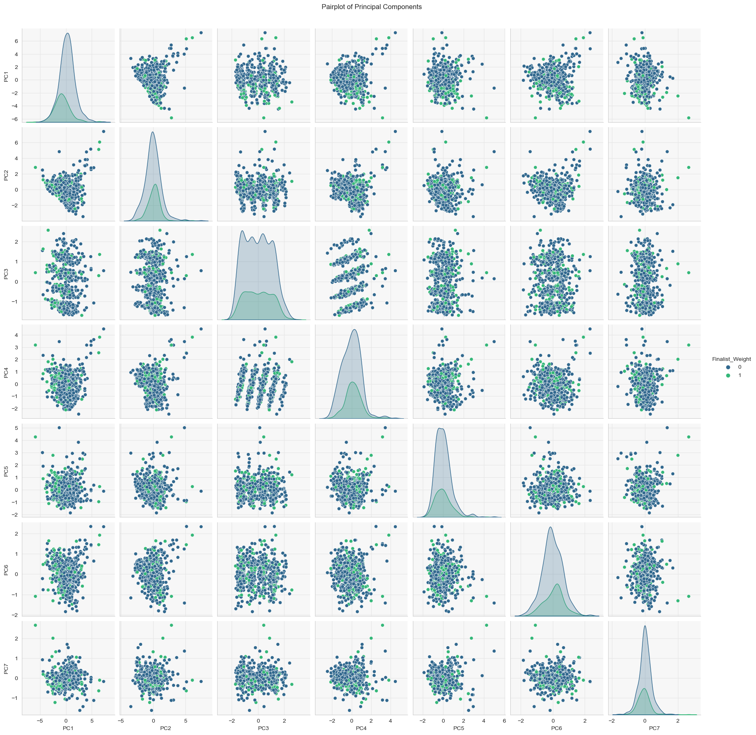
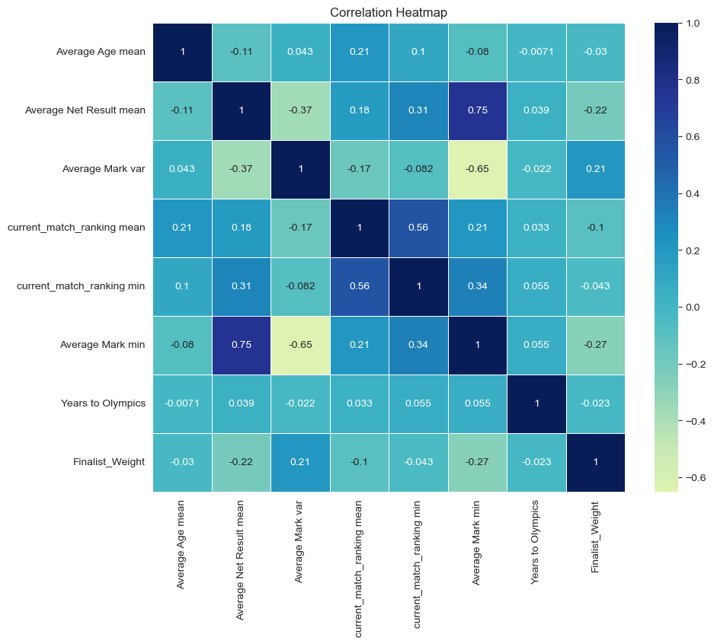
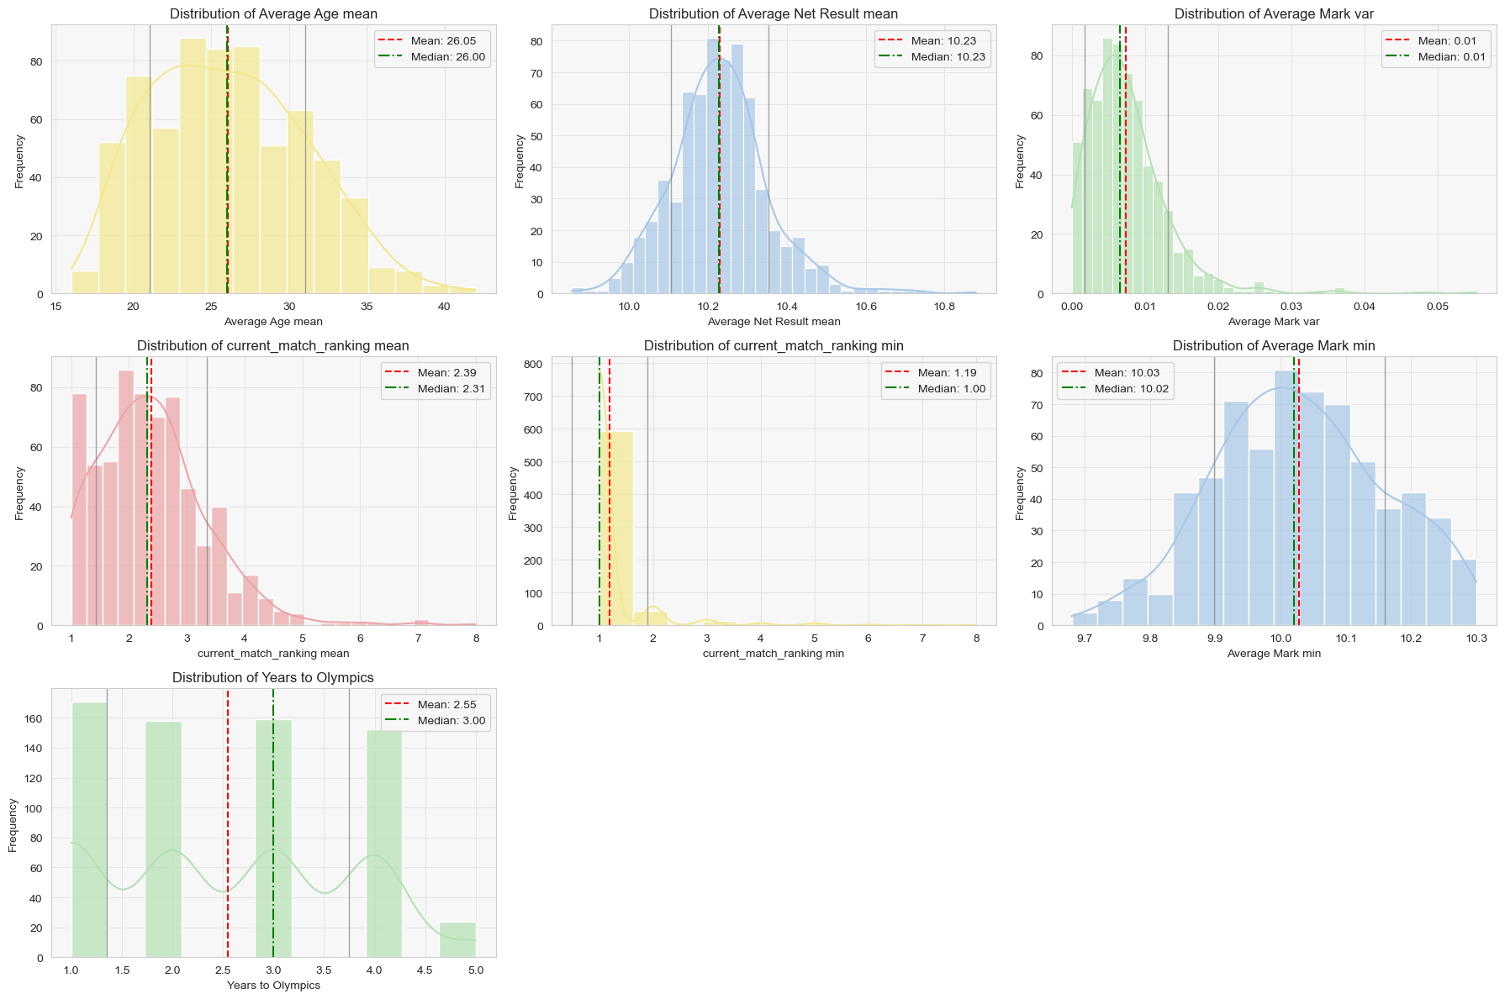
Development : Logistic Regression

Slide 18
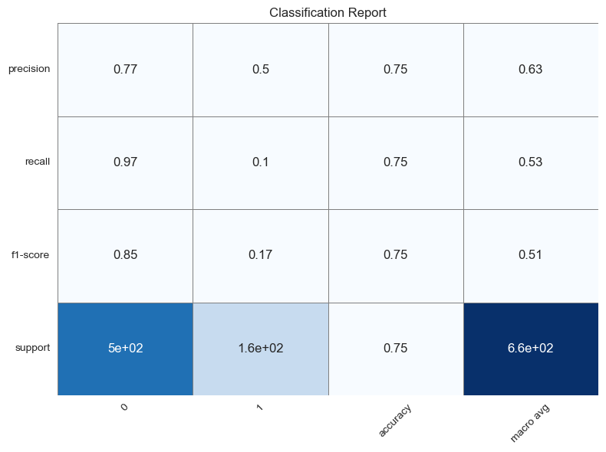
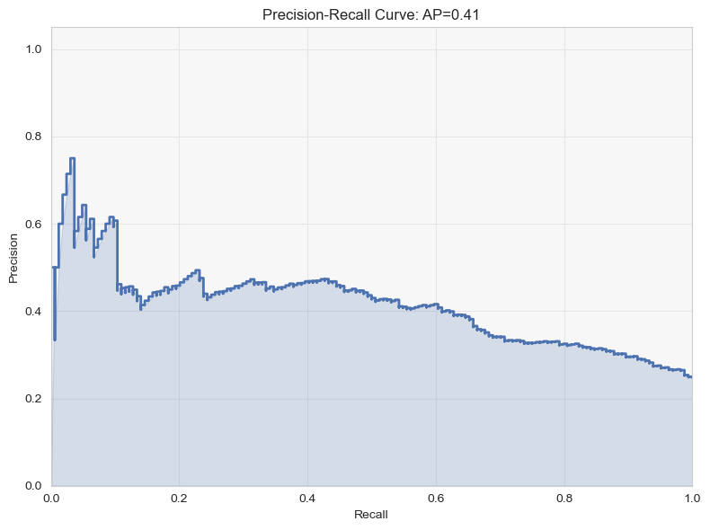
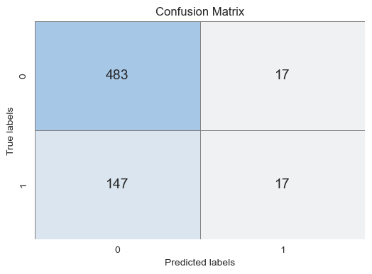
Development : Logistic Regression

Slide 19
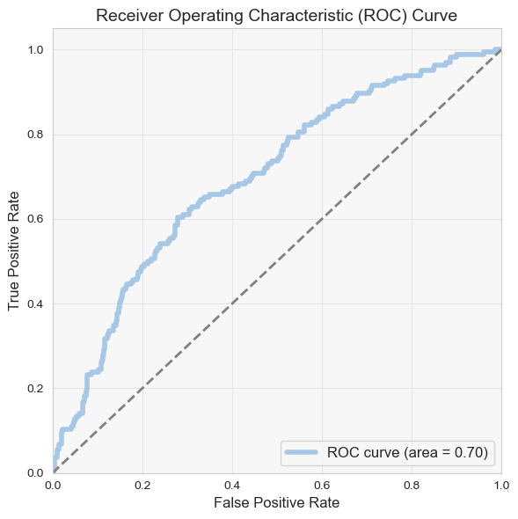
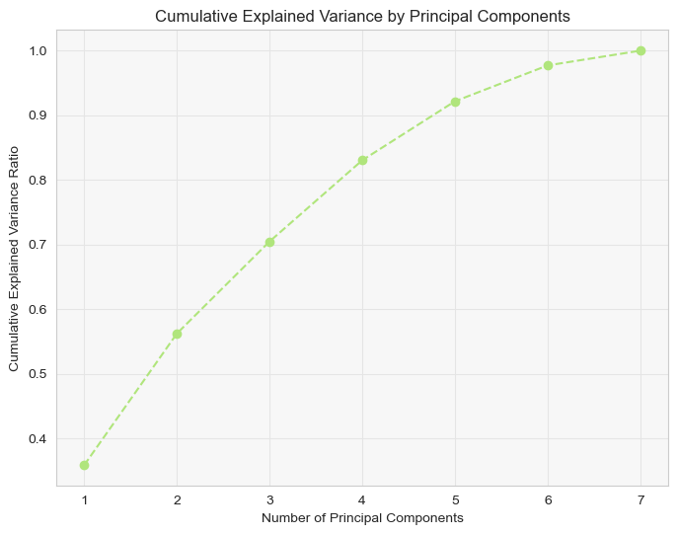
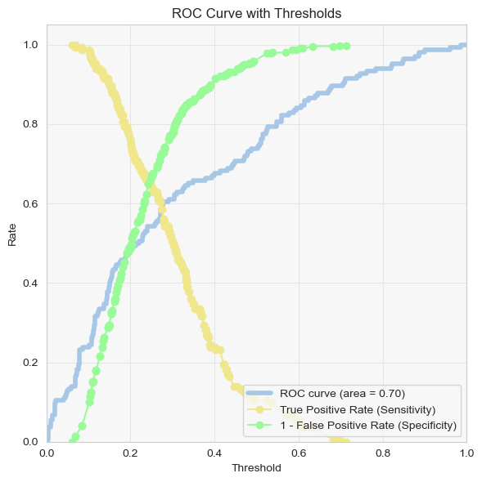
Development : Logistic Regression

Slide 20
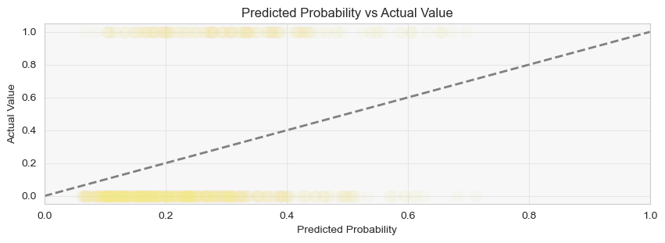
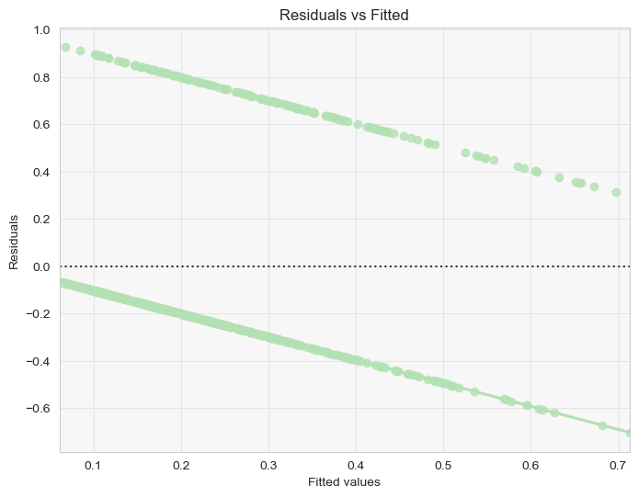
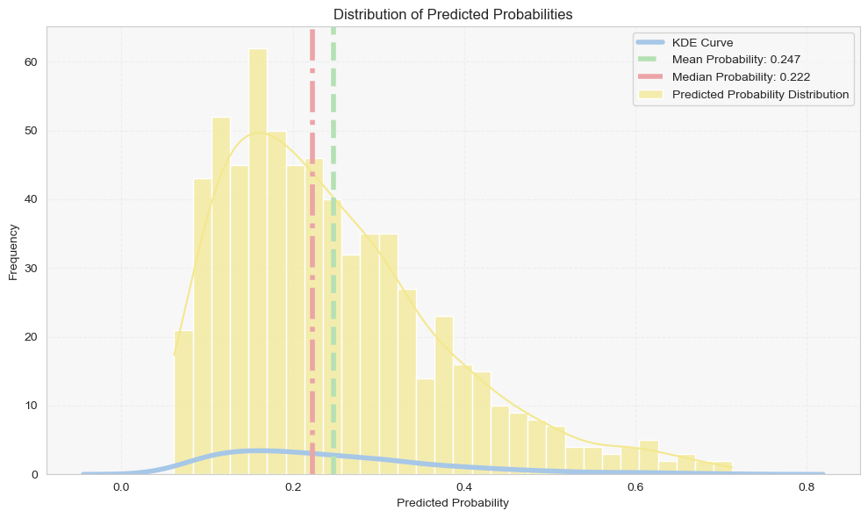
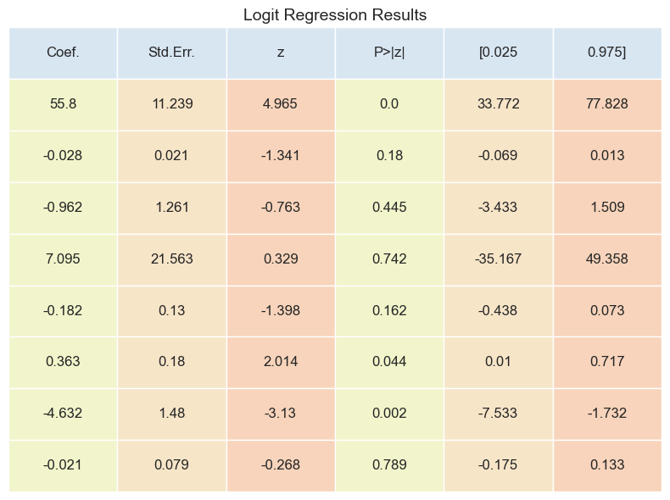
Development : Logistic Regression

Slide 21
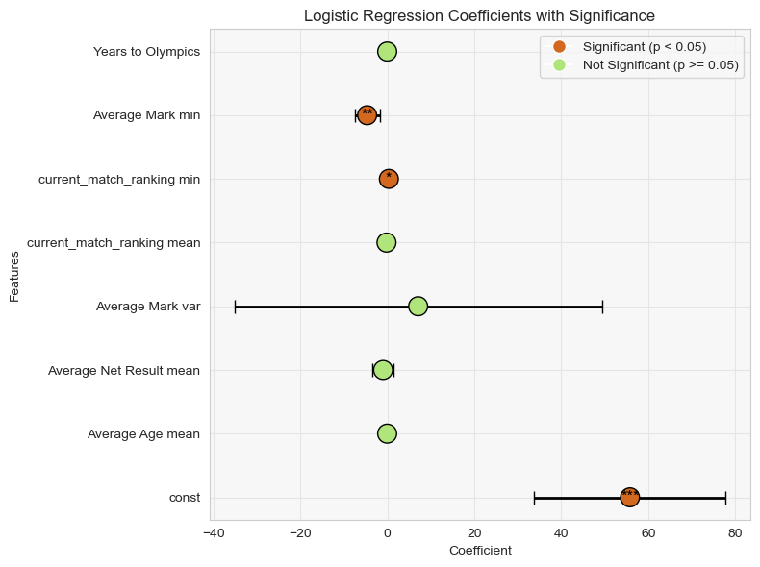
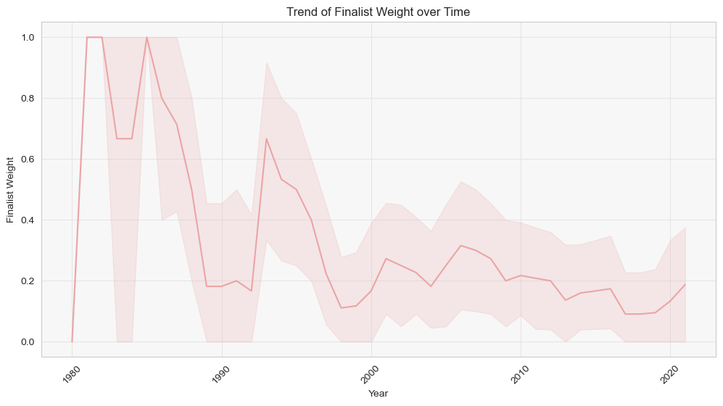
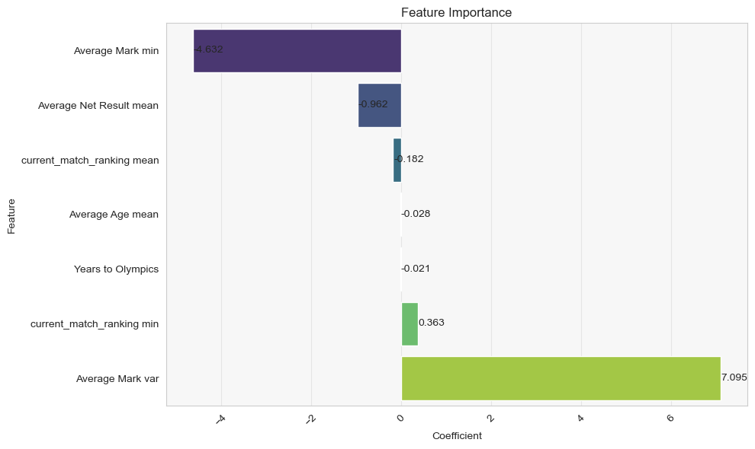
Development : Logistic Regression

Slide 22
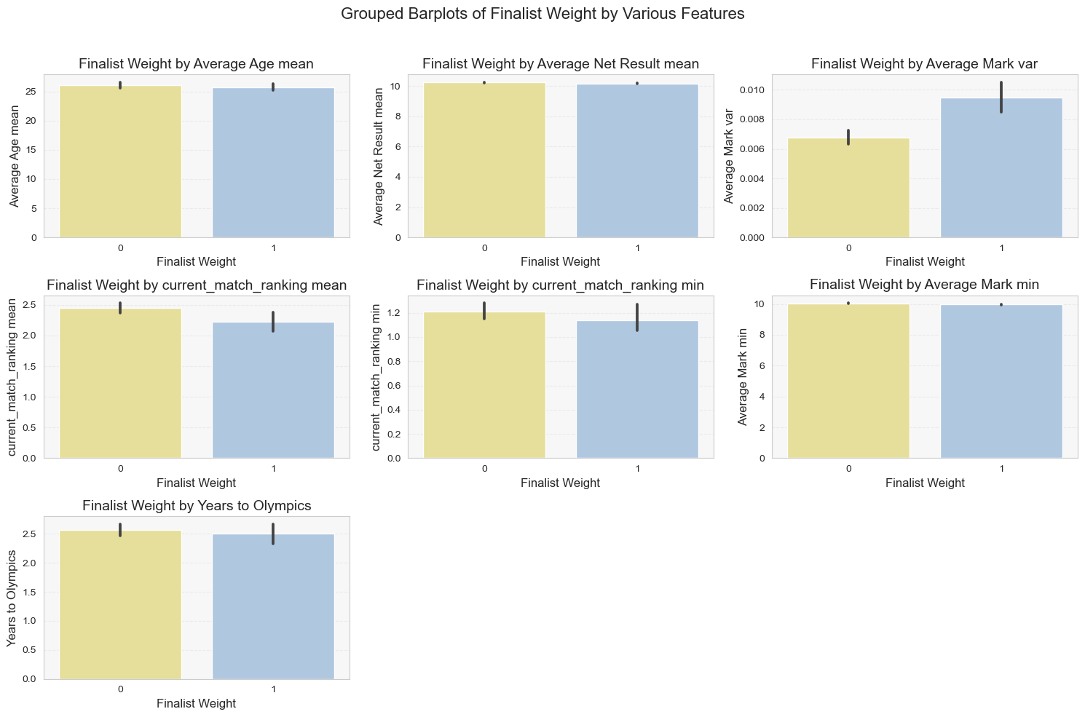
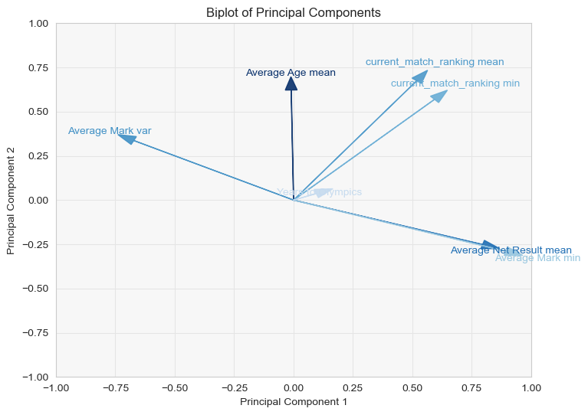
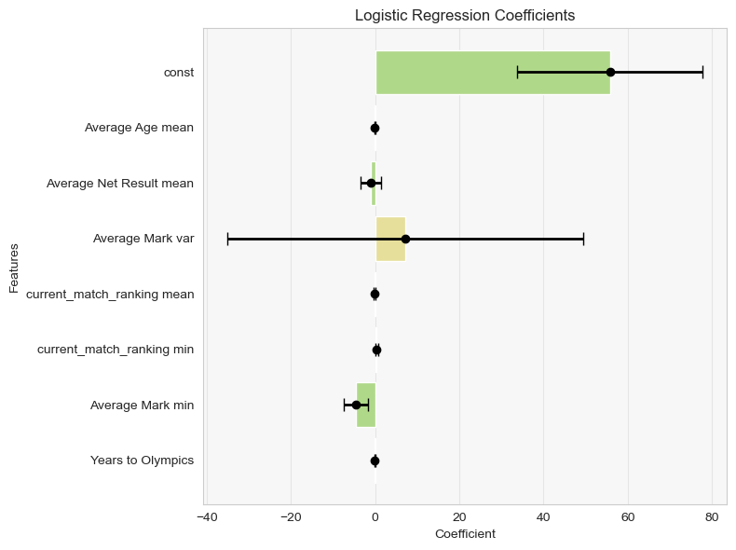
Development : Logistic Regression

Slide 23
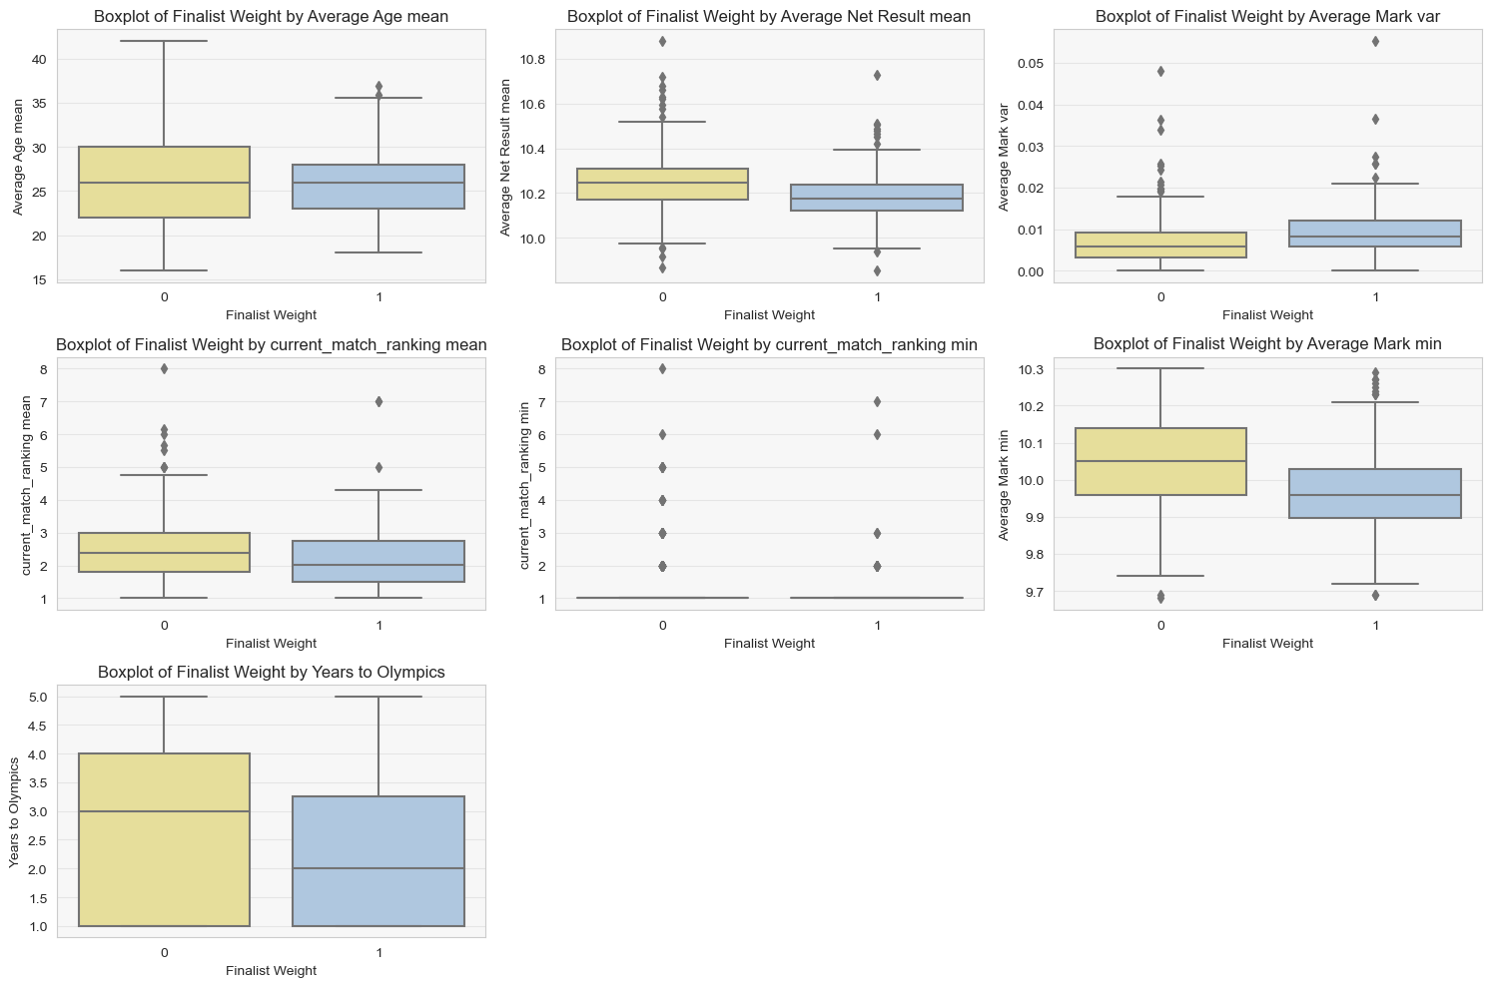
Development : Logistic Regression

Slide 24
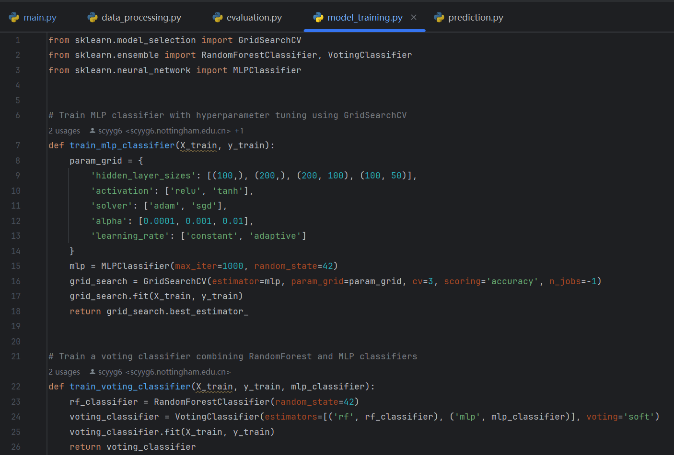
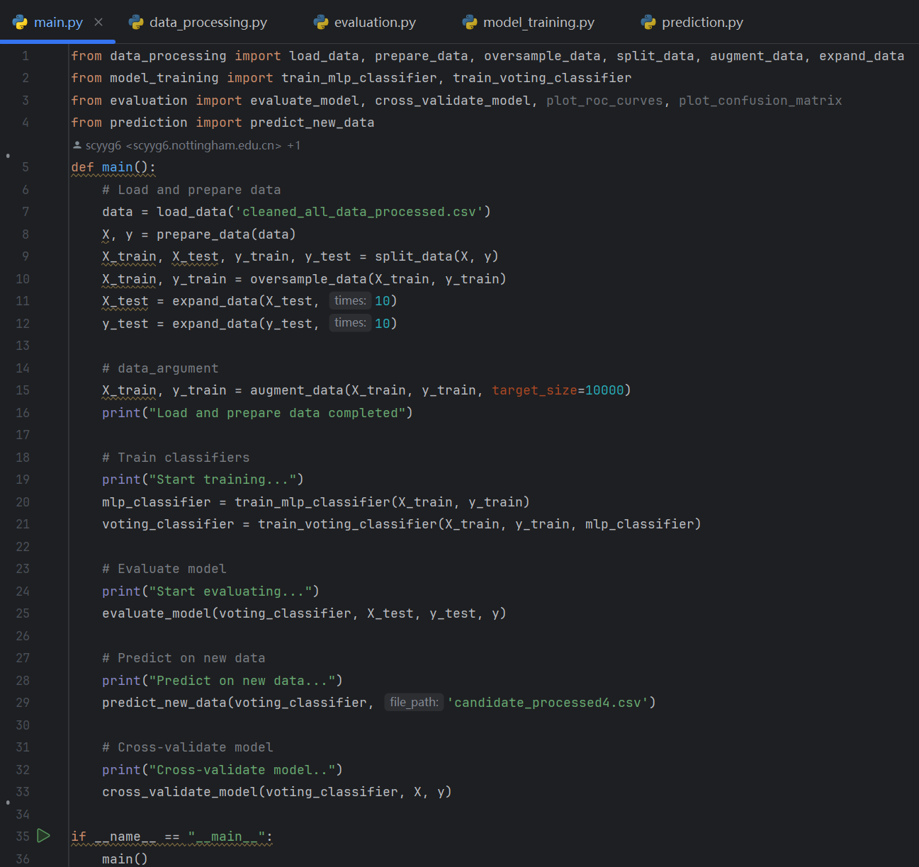
Development : Model Building, Training, and Testing
(Brownlee, 2024)
(Zuoyuan, 2023)

Slide 25
Development : Model Building, Training, and Testing
Cite here SMOTE (ApacheCN, 2023)
ADASYN (Brownlee, 2024)

Slide 26
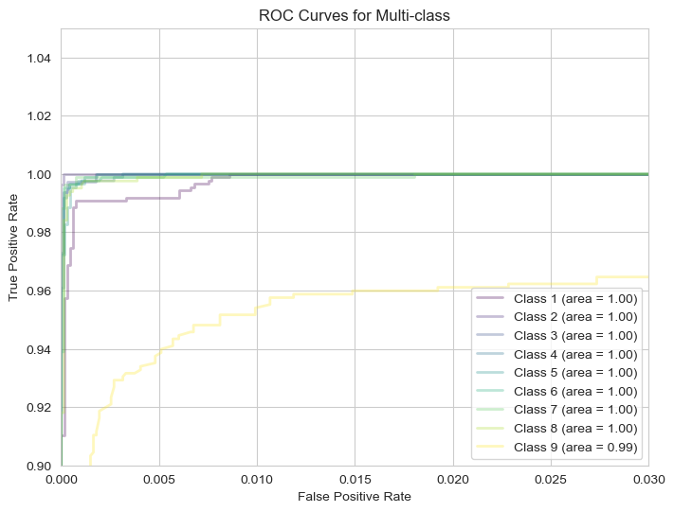
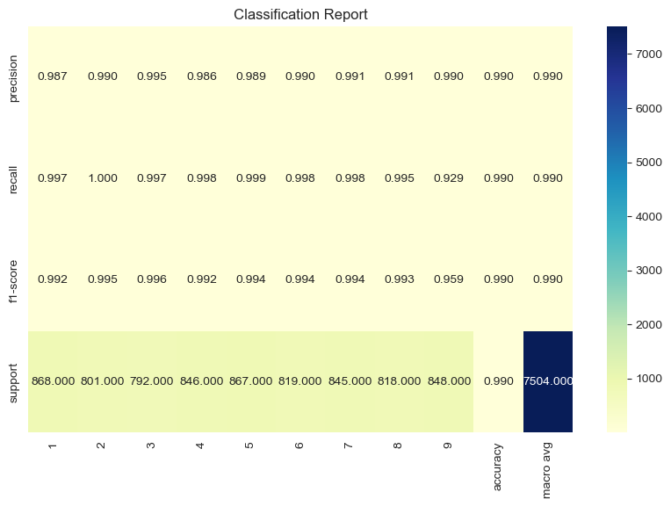
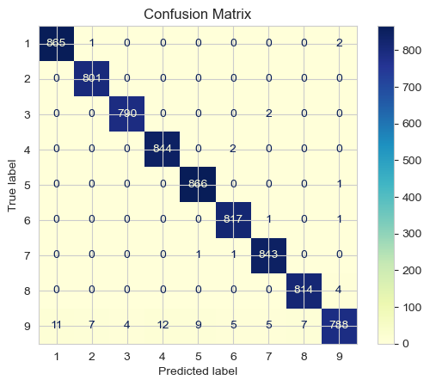
Development : Model Building, Training, and Testing

Slide 27
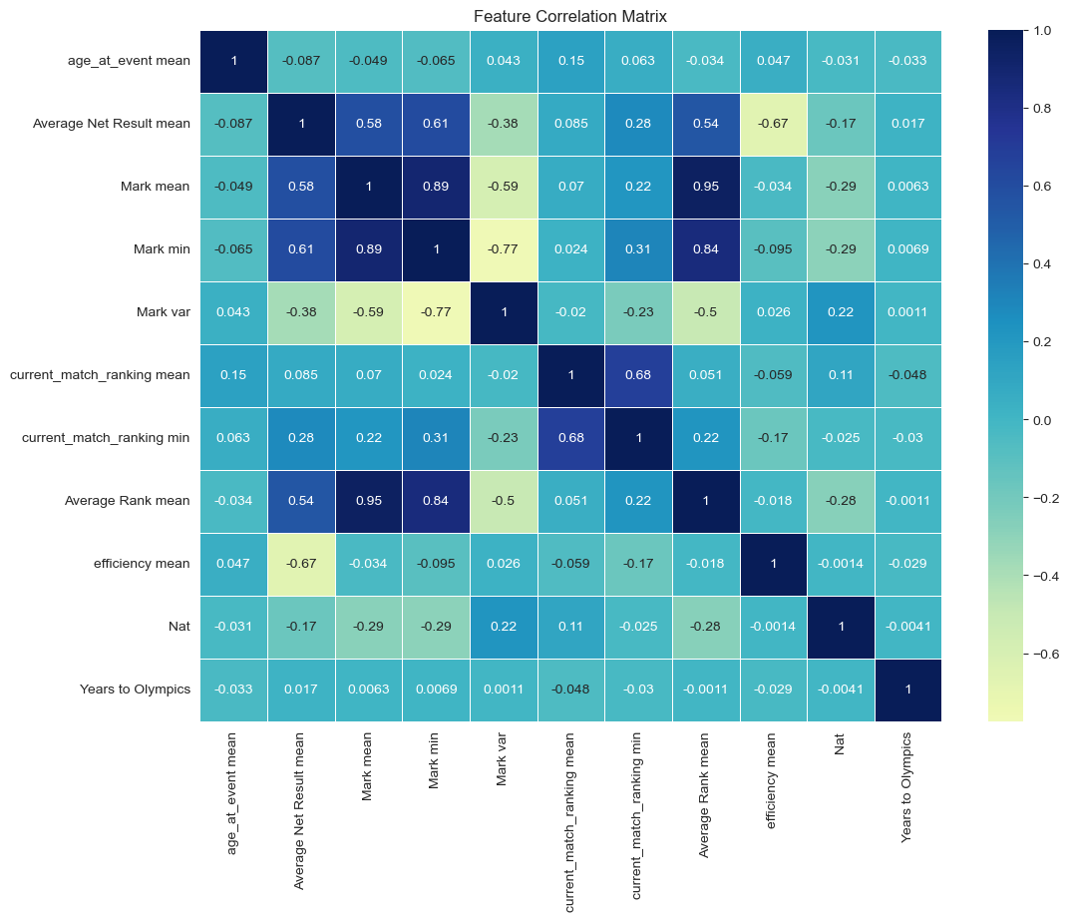
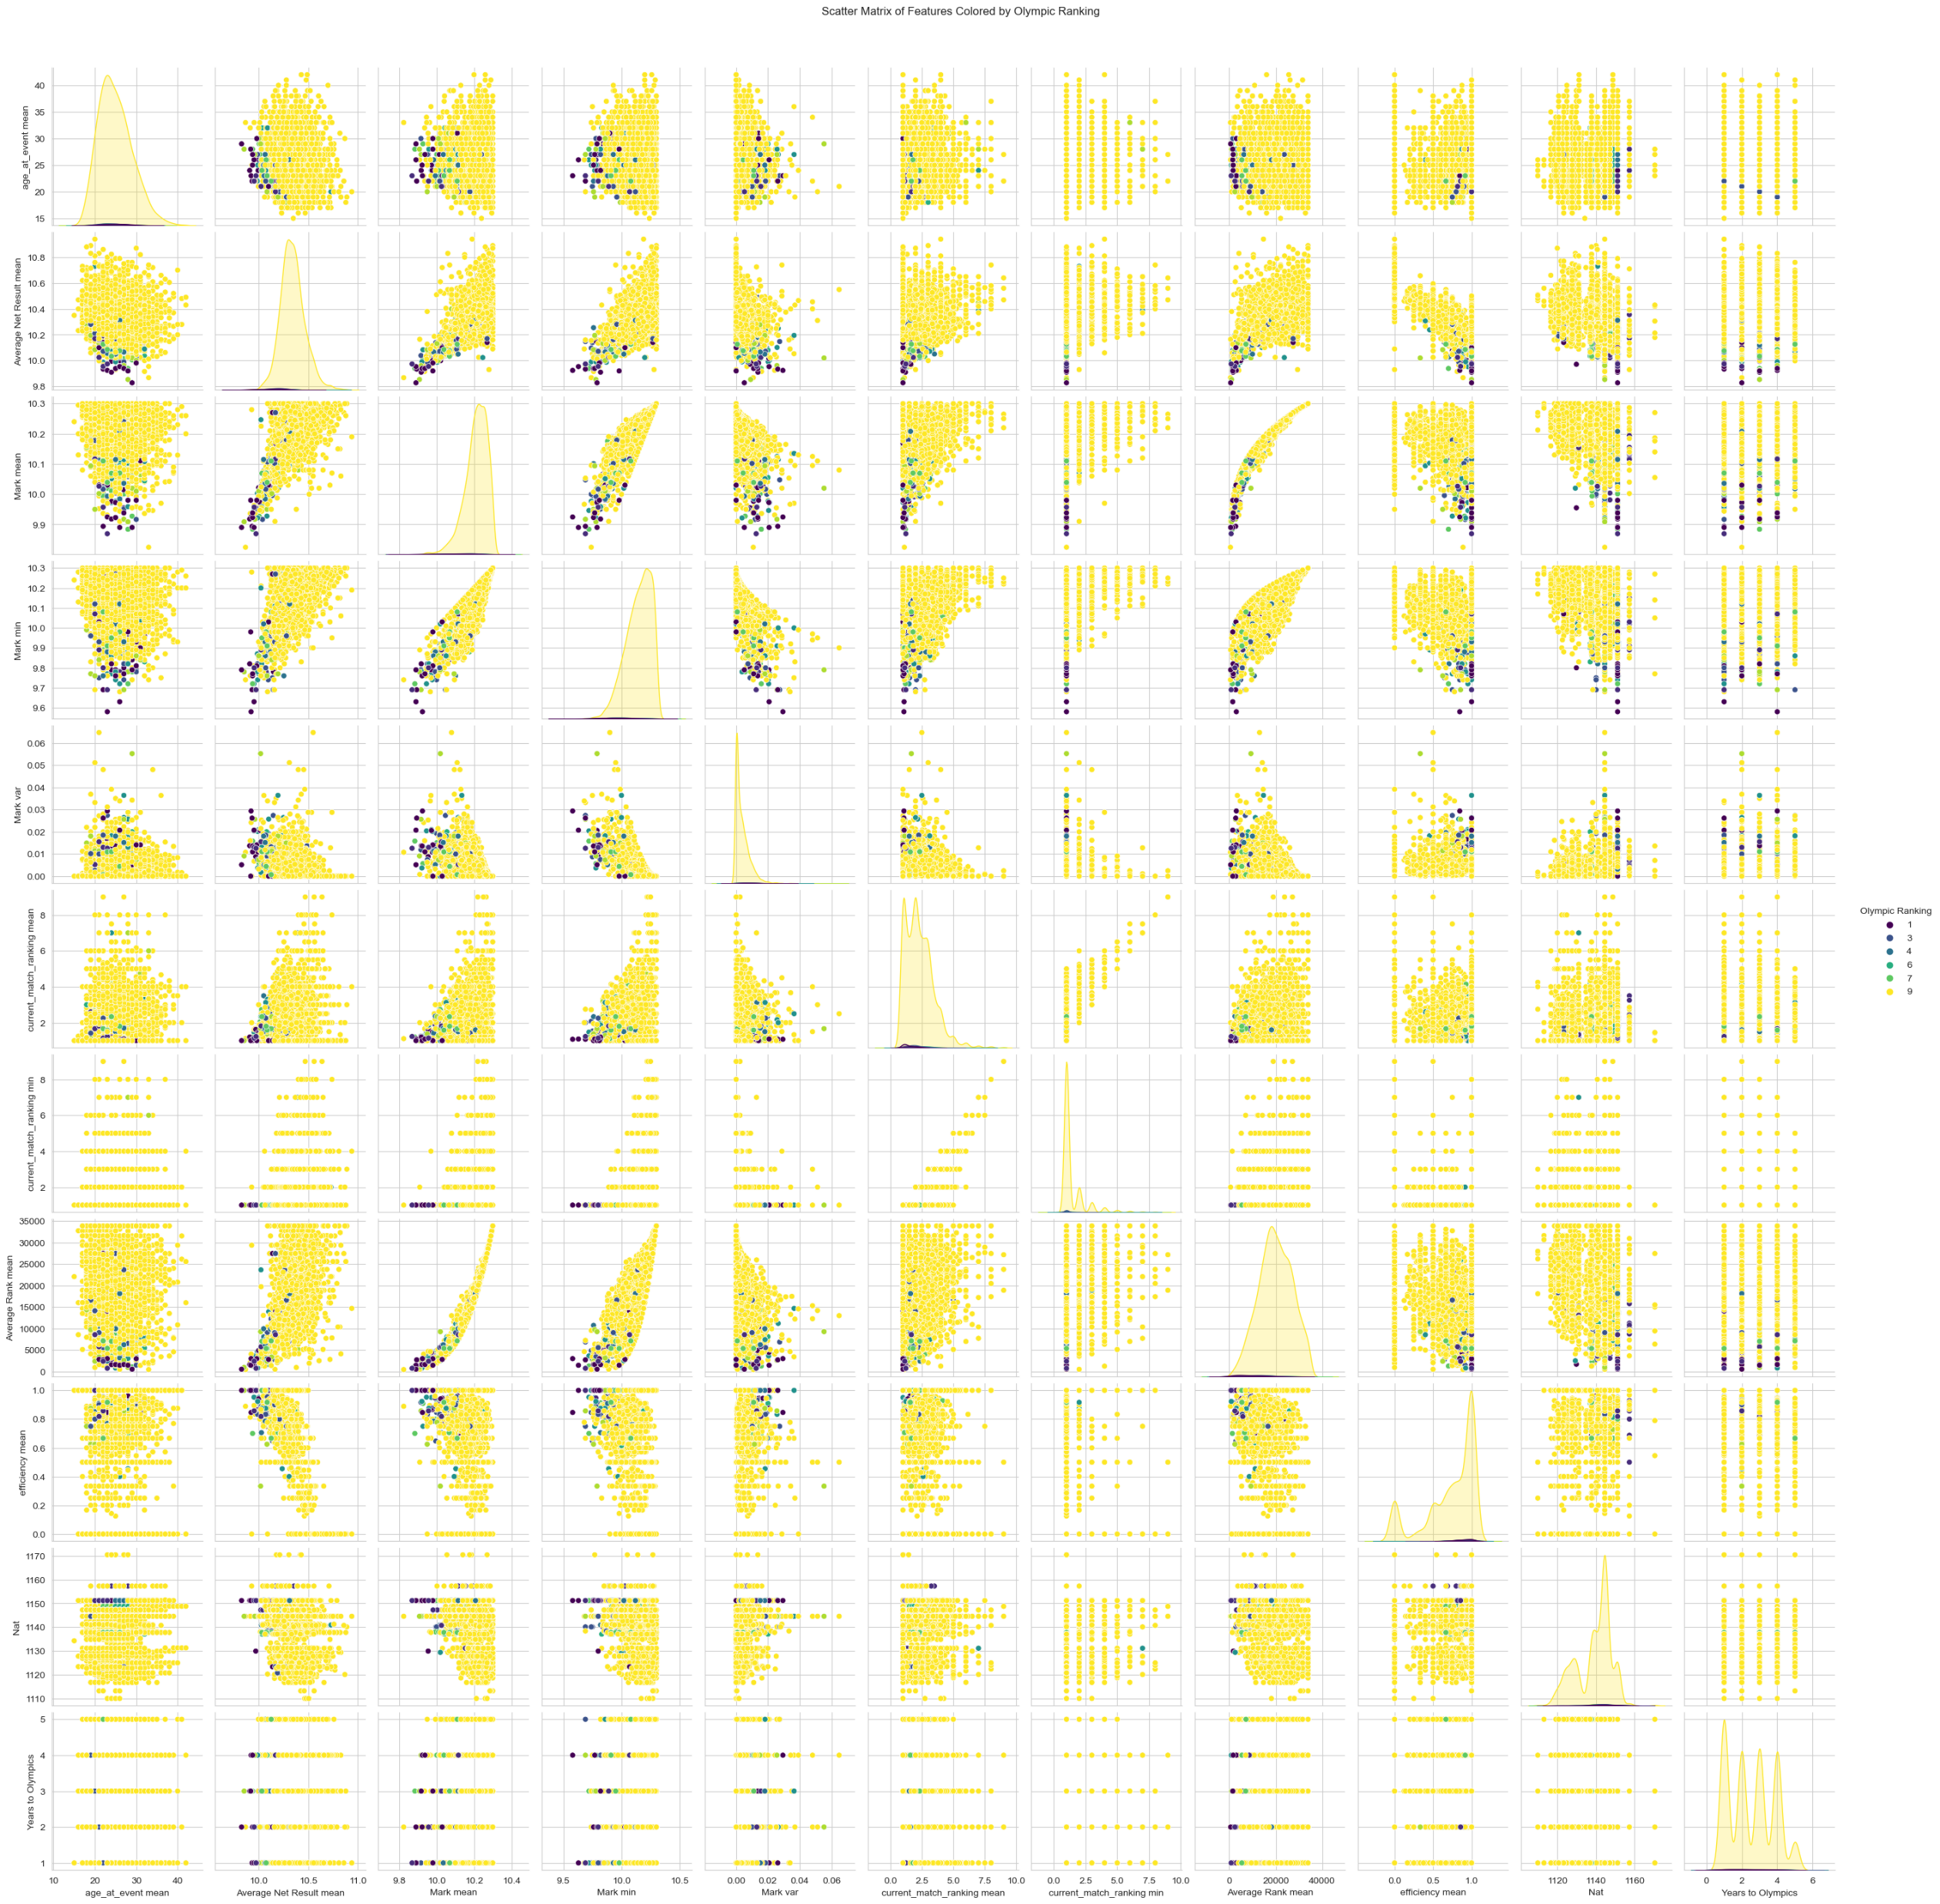
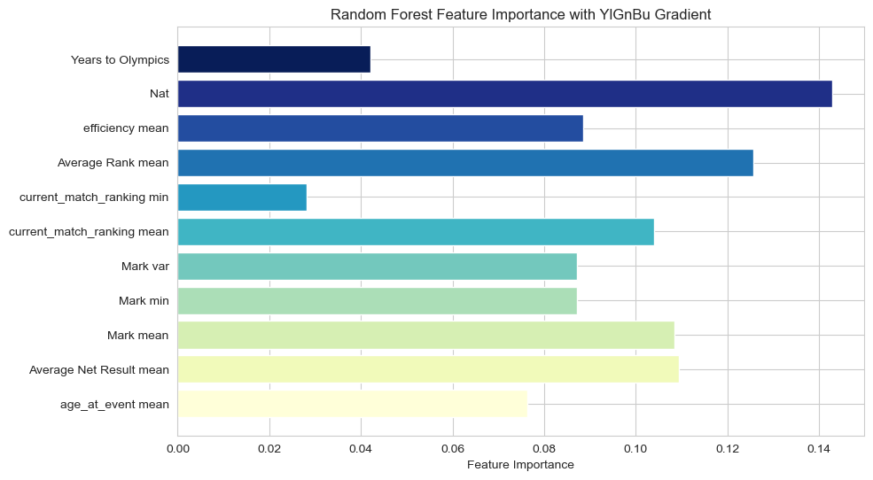

Slide 28
Development : Model Building, Training, and Testing
Cross-validation (scikit-learn, 2024)

Slide 29
Development : Model Evaluation

Slide 30
Conclusion

Slide 31
THANK YOU!

Slide 32
Reference List
ApacheCN. (2023) SMOTE oversampling for imbalanced classification. Available at: https://github.com/apachecn/ml-mastery-zh-pt2 (Accessed: 12 July 2024).
Brownlee, J. (2024) How to Develop a Random Forest Ensemble in Python. Available at: https://machinelearningmastery.com/random-forest-ensemble-in-python/ (Accessed: 17 July 2024).
Brownlee, J. (2024) Random Oversampling and Undersampling for Imbalanced Classification. Available at: https://machinelearningmastery.com/random-oversampling-and-undersampling-for-imbalanced-classification/ (Accessed: 17 July 2024).
scikit-learn. (2024) Cross-validation: evaluating estimator performance. Available at: https://scikit-learn.org/stable/modules/cross_validation.html (Accessed: 17 July 2024).
World Athletics. (2024) Letsile Tebogo. Available at: https://https://worldathletics.org/athletes (Accessed: 17 July 2024).
Zuoyuan, C. (2023) A Complete Machine Learning Project. Available at: https://github.com/confucianzuoyuan/python-tutorials/blob/master/python-data-analysis/docs/2.%E4%B8%80%E4%B8%AA%E5%AE%8C%E6%95%B4%E7%9A%84%E6%9C%BA%E5%99%A8%E5%AD%A6%E4%B9%A0%E9%A1%B9%E7%9B%AE.md (Accessed: 17 July 2024).

